Slide 1
Chapter 5: Process Synchronization

Slide 2
Chapter 5: Process Synchronization
Background
The Critical-Section Problem
Peterson’s Solution
Synchronization Hardware
Mutex Locks
Semaphores
Classic Problems of Synchronization
Monitors
Synchronization Examples
Alternative Approaches

Slide 3
Objectives
To present the concept of process synchronization.
To introduce the critical-section problem, whose solutions can be used to ensure the consistency of shared data
To present both software and hardware solutions of the critical-section problem
To examine several classical process-synchronization problems
To explore several tools that are used to solve process synchronization problems

Slide 4
Background
Processes can execute concurrently
May be interrupted at any time, partially completing execution
Concurrent access to shared data may result in data inconsistency
Maintaining data consistency requires mechanisms to ensure the orderly execution of cooperating processes
Illustration of the problem: Suppose that we wanted to provide a solution to the consumer-producer problem that fills all the buffers. We can do so by having an integer counter that keeps track of the number of full buffers. Initially, counter is set to 0. It is incremented by the producer after it produces a new buffer and is decremented by the consumer after it consumes a buffer.

Slide 5
Producer
while (true) { /* produce an item in next produced */
while (counter == BUFFER_SIZE) ;
/* do nothing */
buffer[in] = next_produced;
in = (in + 1) % BUFFER_SIZE;
counter++;
}

Slide 6
Consumer
while (true) {
while (counter == 0)
; /* do nothing */
next_consumed = buffer[out];
out = (out + 1) % BUFFER_SIZE;
counter--;
/* consume the item in next consumed */
}

Slide 7
Race Condition
counter++ could be implemented as register1 = counter register1 = register1 + 1 counter = register1
counter-- could be implemented as register2 = counter register2 = register2 - 1 counter = register2
Consider this execution interleaving with “count = 5” initially:
S0: producer execute register1 = counter {register1 = 5} S1: producer execute register1 = register1 + 1 {register1 = 6} S2: consumer execute register2 = counter {register2 = 5} S3: consumer execute register2 = register2 – 1 {register2 = 4} S4: producer execute counter = register1 {counter = 6 } S5: consumer execute counter = register2 {counter = 4}

Slide 8
Critical Section Problem
Consider system of n processes {p₀, p₁, … p_{n-1}}
Each process has critical section segment of code
Process may be changing common variables, updating table, writing file, etc
When one process in critical section, no other may be in its critical section
Critical section problem is to design protocol to solve this
Each process must ask permission to enter critical section in entry section, may follow critical section with exit section, then remainder section

Slide 9
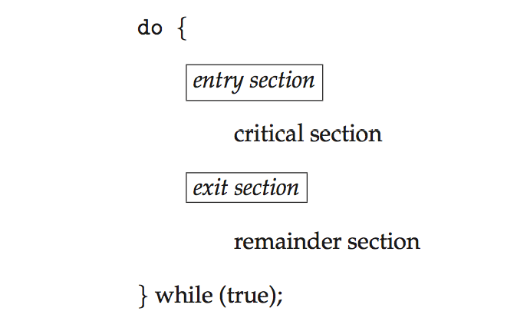
Critical Section
General structure of process P_{i}

Slide 10
Algorithm for Process P_{i}
do {
while (turn == j);
critical section
turn = j;
remainder section
} while (true);

Slide 11
Solution to Critical-Section Problem
1. Mutual Exclusion - If process P_{i} is executing in its critical section, then no other processes can be executing in their critical sections
2. Progress - If no process is executing in its critical section and there exist some processes that wish to enter their critical section, then the selection of the processes that will enter the critical section next cannot be postponed indefinitely
3. Bounded Waiting - A bound must exist on the number of times that other processes are allowed to enter their critical sections after a process has made a request to enter its critical section and before that request is granted
Assume that each process executes at a nonzero speed
No assumption concerning relative speed of the n processes

Slide 12
Critical-Section Handling in OS
Two approaches depending on if kernel is preemptive or non- preemptive
Preemptive – allows preemption of process when running in kernel mode
Non-preemptive – runs until exits kernel mode, blocks, or voluntarily yields CPU
Essentially free of race conditions in kernel mode

Slide 13
Peterson’s Solution
Good algorithmic description of solving the problem
Two process solution
Assume that the load and store machine-language instructions are atomic; that is, cannot be interrupted
The two processes share two variables:
int turn;
Boolean flag[2]
The variable turn indicates whose turn it is to enter the critical section
The flag array is used to indicate if a process is ready to enter the critical section. flag[i] = true implies that process P_{i} is ready!

Slide 14
Algorithm for Process P_{i}
do {
flag[i] = true;
turn = j;
while (flag[j] && turn = = j);
critical section
flag[i] = false;
remainder section
} while (true);

Slide 15
Peterson’s Solution (Cont.)
Provable that the three CS requirement are met:
1. Mutual exclusion is preserved
P_{i} enters CS only if:
either flag[j] = false or turn = i
2. Progress requirement is satisfied
3. Bounded-waiting requirement is met

Slide 16
Synchronization Hardware
Many systems provide hardware support for implementing the critical section code.
All solutions below based on idea of locking
Protecting critical regions via locks
Uniprocessors – could disable interrupts
Currently running code would execute without preemption
Generally too inefficient on multiprocessor systems
Operating systems using this not broadly scalable
Modern machines provide special atomic hardware instructions
Atomic = non-interruptible
Either test memory word and set value
Or swap contents of two memory words

Slide 17
Solution to Critical-section Problem Using Locks
do {
acquire lock
critical section
release lock
remainder section
} while (TRUE);

Slide 18
test_and_set Instruction
Definition:
boolean test_and_set (boolean *target)
{
boolean rv = *target;
*target = TRUE;
return rv:
}
Executed atomically
Returns the original value of passed parameter
Set the new value of passed parameter to “TRUE”.

Slide 19
Solution using test_and_set()
Shared Boolean variable lock, initialized to FALSE
Solution:
do { while (test_and_set(&lock))
; /* do nothing */
/* critical section */
lock = false;
/* remainder section */
} while (true);

Slide 20
compare_and_swap Instruction
Definition:
int compare _and_swap(int *value, int expected, int new_value) {
int temp = *value;
if (*value == expected)
*value = new_value;
return temp;
}
Executed atomically
Returns the original value of passed parameter “value”
Set the variable “value” the value of the passed parameter “new_value” but only if “value” ==“expected”. That is, the swap takes place only under this condition.

Slide 21
Solution using compare_and_swap
Shared integer “lock” initialized to 0;
Solution:
do { while (compare_and_swap(&lock, 0, 1) != 0)
; /* do nothing */
/* critical section */
lock = 0;
/* remainder section */
} while (true);

Slide 22
Bounded-waiting Mutual Exclusion with test_and_set
do { waiting[i] = true; key = true; while (waiting[i] && key)
key = test_and_set(&lock);
waiting[i] = false;
/* critical section */
j = (i + 1) % n;
while ((j != i) && !waiting[j])
j = (j + 1) % n;
if (j == i)
lock = false;
else
waiting[j] = false;
/* remainder section */
} while (true);

Slide 23
Mutex Locks
Previous solutions are complicated and generally inaccessible to application programmers
OS designers build software tools to solve critical section problem
Simplest is mutex lock
Protect a critical section by first acquire() a lock then release() the lock
Boolean variable indicating if lock is available or not
Calls to acquire() and release() must be atomic
Usually implemented via hardware atomic instructions
But this solution requires busy waiting
This lock therefore called a spinlock

Slide 24
acquire() and release()
acquire() { while (!available)
; /* busy wait */
available = false;;
}
release() {
available = true;
}
do {
acquire lock
critical section
release lock
remainder section
} while (true);

Slide 25
Semaphore
Synchronization tool that provides more sophisticated ways (than Mutex locks) for process to synchronize their activities.
Semaphore S – integer variable
Can only be accessed via two indivisible (atomic) operations
wait() and signal()
Originally called P() and V()
Definition of the wait() operation
wait(S) {
while (S <= 0)
; // busy wait
S--;
}
Definition of the signal() operation
signal(S) {
S++;
}

Slide 26
Semaphore Usage
Counting semaphore – integer value can range over an unrestricted domain
Binary semaphore – integer value can range only between 0 and 1
Same as a mutex lock
Can solve various synchronization problems
Consider P₁ and P₂ that require S₁ to happen before S₂
Create a semaphore “synch” initialized to 0
P1:
S₁;
signal(synch);
P2:
wait(synch);
S₂;
Can implement a counting semaphore S as a binary semaphore

Slide 27
Semaphore Implementation
Must guarantee that no two processes can execute the wait() and signal() on the same semaphore at the same time
Thus, the implementation becomes the critical section problem where the wait and signal code are placed in the critical section
Could now have busy waiting in critical section implementation
But implementation code is short
Little busy waiting if critical section rarely occupied
Note that applications may spend lots of time in critical sections and therefore this is not a good solution

Slide 28
Semaphore Implementation with no Busy waiting
With each semaphore there is an associated waiting queue
Each entry in a waiting queue has two data items:
value (of type integer)
pointer to next record in the list
Two operations:
block – place the process invoking the operation on the appropriate waiting queue
wakeup – remove one of processes in the waiting queue and place it in the ready queue
typedef struct{
int value;
struct process *list;
} semaphore;

Slide 29
Implementation with no Busy waiting (Cont.)
wait(semaphore *S) {
S->value--;
if (S->value < 0) { add this process to S->list;
block();
}
}
signal(semaphore *S) {
S->value++;
if (S->value <= 0) { remove a process P from S->list;
wakeup(P);
}
}

Slide 30
Deadlock and Starvation
Deadlock – two or more processes are waiting indefinitely for an event that can be caused by only one of the waiting processes
Let S and Q be two semaphores initialized to 1
P₀ P₁
wait(S); wait(Q);
wait(Q); wait(S);
... ...
signal(S); signal(Q);
signal(Q); signal(S);
Starvation – indefinite blocking
A process may never be removed from the semaphore queue in which it is suspended
Priority Inversion – Scheduling problem when lower-priority process holds a lock needed by higher-priority process
Solved via priority-inheritance protocol

Slide 31
Classical Problems of Synchronization
Classical problems used to test newly-proposed synchronization schemes
Bounded-Buffer Problem
Readers and Writers Problem
Dining-Philosophers Problem

Slide 32
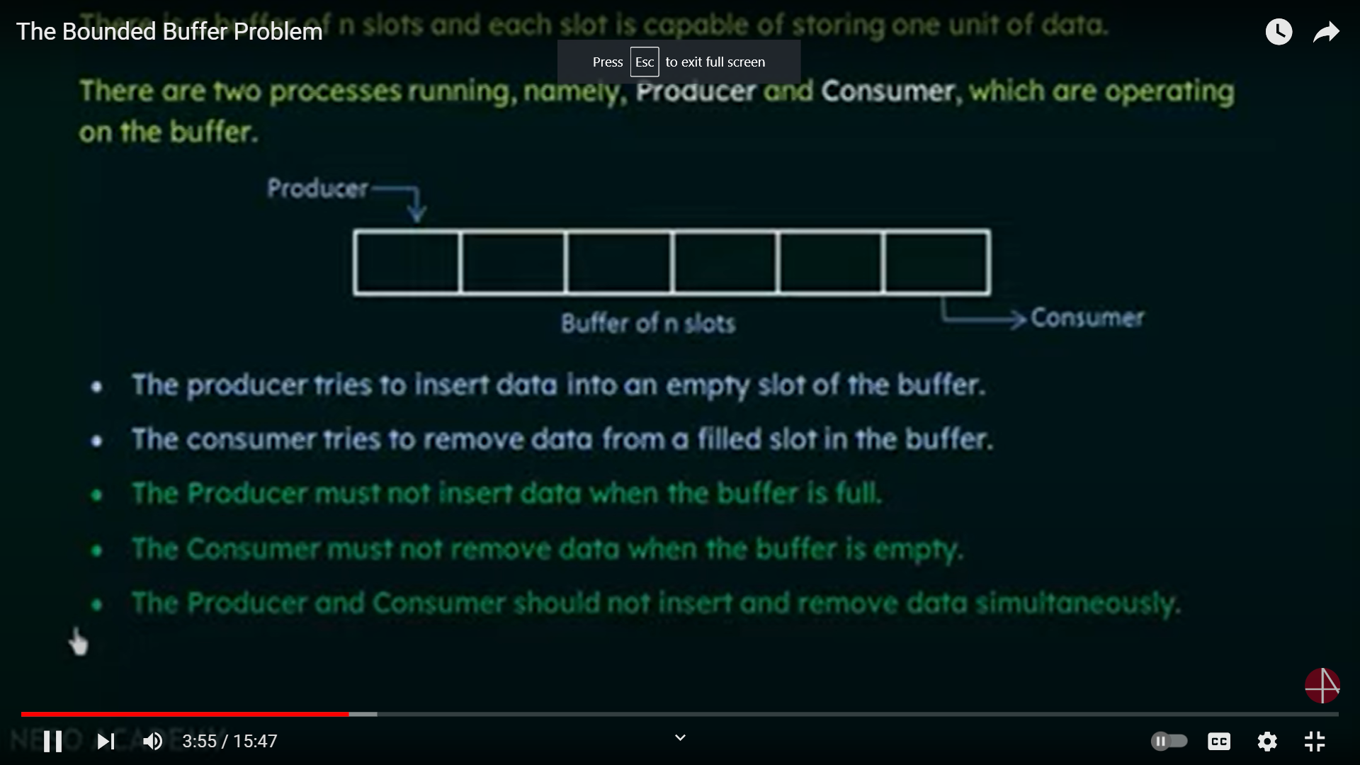

Slide 33
64.66.72.74..82.90.102.114
181,82.86.88.200,203.213223.231,238
no

Slide 34
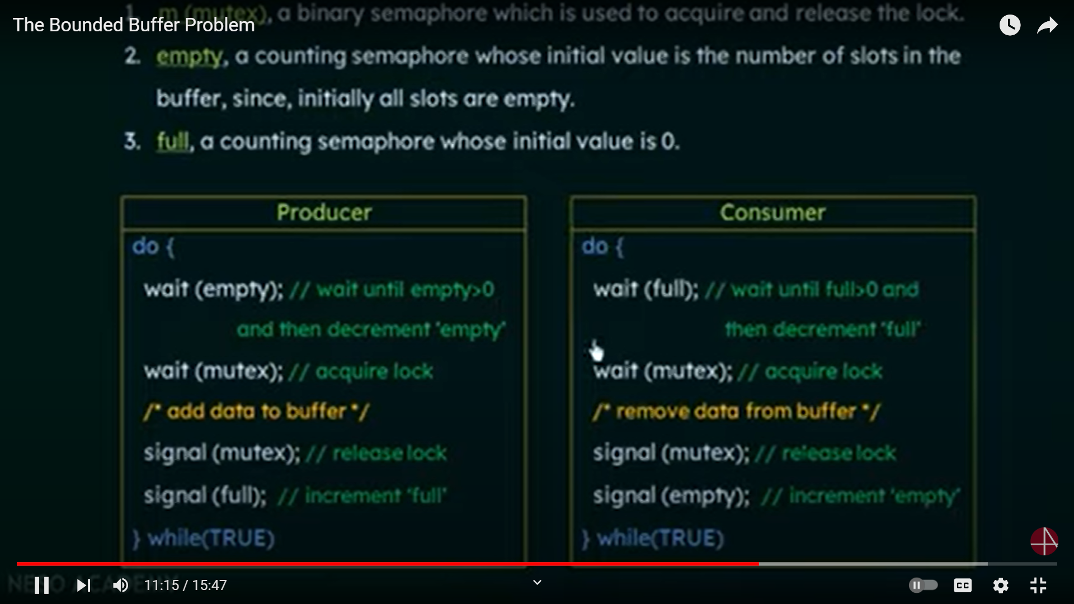

Slide 35
Semaphore
Synchronization tool that provides more sophisticated ways (than Mutex locks) for process to synchronize their activities.
Semaphore S – integer variable
Can only be accessed via two indivisible (atomic) operations
wait() and signal()
Originally called P() and V()
Definition of the wait() operation
wait(S) {
while (S <= 0)
; // busy wait
S--;
}
Definition of the signal() operation
signal(S) {
S++;
}

Slide 36
Bounded-Buffer Problem
n buffers, each can hold one item
m(mutex) is binary Semaphore because it uses only acquire and release.
Semaphore mutex initialized to the value 1
Semaphore full initialized to the value 0(Keeps the track of how many are slots are filled in the buffer)
Semaphore empty initialized to the value n(It is a value of total number of slots in the buffer,intially all slots are empty)
If empty > 0 then there are empty slots.
If empty = 0 then there are no emty slots
wait Semaphore-Always decrements
signal Semaphore- Always Increments
mutex acquires the lock the consumer cannot acess it

Slide 37
Bounded Buffer Problem (Cont.)
The structure of the producer process
do {
... /* produce an item in next_produced */
...
wait(empty); decrements the value
wait(mutex);//acquire lock
... /* add next produced to the buffer */
... (nextp will be having the data what need to added inside the buffer.)
signal(mutex); //release the lock
signal(full);//increments full
} while (true);

Slide 38
Bounded Buffer Problem (Cont.)
The structure of the consumer process
Do {
wait(full); //wait untill full > 0 and then decrement full because it will check wether the buffer is full or not then only it can free the space.
wait(mutex); /acquires lock
... /* remove an item from buffer to next_consumed */
...
signal(mutex); //release lock
signal(empty); //increment empty
... /* consume the item in next consumed */
... } while (true);

Slide 39
Readers-Writers Problem
A data set is shared among a number of concurrent processes
Readers – only read the data set; they do not perform any updates
Writers – can both read and write
Problem – allow multiple readers to read at the same time
Only one single writer can access the shared data at the same time
Several variations of how readers and writers are considered – all involve some form of priorities
Shared Data
Data set
Semaphore rw_mutex initialized to 1
Semaphore mutex initialized to 1
Integer read_count initialized to 0(readcnt tells the number of processes performing read in the critical section, initially 0)

Slide 40
Readers-Writers Problem
There are four types of cases that could happen here.
Case Process 1 Process 2 Allowed/Not Allowed
Case 1 Writing-Writing Not Allowed
Case 2 Writing Reading Not Allowed
Case 3 ReadingWriting Not Allowed
Case 4 Reading Reading Allowed

Slide 41
Readers-Writers Problem (Cont.)
The structure of a writer process
do { wait(rw_mutex);
... /* writing is performed */
...
signal(rw_mutex);
} while (true);

Slide 42
Readers-Writers Problem (Cont.)
The structure of a reader process
do { wait(mutex); read_count++; if (read_count == 1)
wait(rw_mutex);
signal(mutex);
... /* reading is performed */
...
wait(mutex); read count--; if (read_count == 0)
signal(rw_mutex);
signal(mutex);
} while (true);

Slide 43
Readers-Writers Problem Variations
First variation – no reader kept waiting unless writer has permission to use shared object
Second variation – once writer is ready, it performs the write ASAP
Both may have starvation leading to even more variations
Problem is solved on some systems by kernel providing reader-writer locks

Slide 44
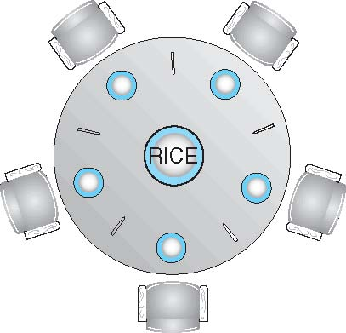
Dining-Philosophers Problem
Philosophers spend their lives alternating thinking and eating
Don’t interact with their neighbors, occasionally try to pick up 2 chopsticks (one at a time) to eat from bowl
Need both to eat, then release both when done
In the case of 5 philosophers
Shared data
Bowl of rice (data set)
Semaphore chopstick [5] initialized to 1

Slide 45
Dining-Philosophers Problem Algorithm
The structure of Philosopher i:
do {
wait (chopstick[i] );
wait (chopStick[ (i + 1) % 5] );
// eat
signal (chopstick[i] );
signal (chopstick[ (i + 1) % 5] );
// think
} while (TRUE);
What is the problem with this algorithm?

Slide 46
Dining-Philosophers Problem Algorithm (Cont.)
Deadlock handling
Allow at most 4 philosophers to be sitting simultaneously at the table.
Allow a philosopher to pick up the forks only if both are available (picking must be done in a critical section.
Use an asymmetric solution -- an odd-numbered philosopher picks up first the left chopstick and then the right chopstick. Even-numbered philosopher picks up first the right chopstick and then the left chopstick.

Slide 47
Problems with Semaphores
Incorrect use of semaphore operations:
signal (mutex) …. wait (mutex)
wait (mutex) … wait (mutex)
Omitting of wait (mutex) or signal (mutex) (or both)
Deadlock and starvation are possible.

Slide 48
Monitors
A high-level abstraction that provides a convenient and effective mechanism for process synchronization
Abstract data type, internal variables only accessible by code within the procedure
Only one process may be active within the monitor at a time
But not powerful enough to model some synchronization schemes
monitor monitor-name
{
// shared variable declarations
procedure P1 (…) { …. }
procedure Pn (…) {……}
Initialization code (…) { … }
}
}

Slide 49
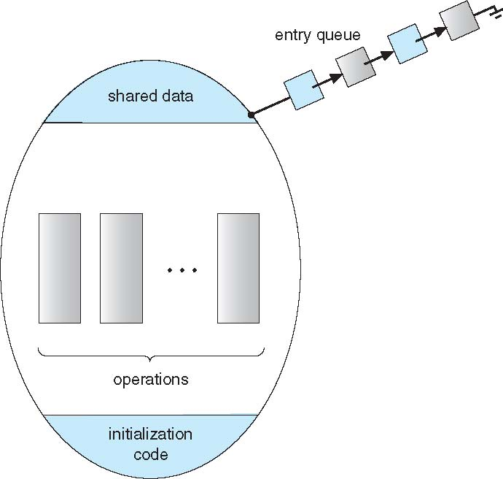
Schematic view of a Monitor

Slide 50
Condition Variables
condition x, y;
Two operations are allowed on a condition variable:
x.wait() – a process that invokes the operation is suspended until x.signal()
x.signal() – resumes one of processes (if any) that invoked x.wait()
If no x.wait() on the variable, then it has no effect on the variable

Slide 51
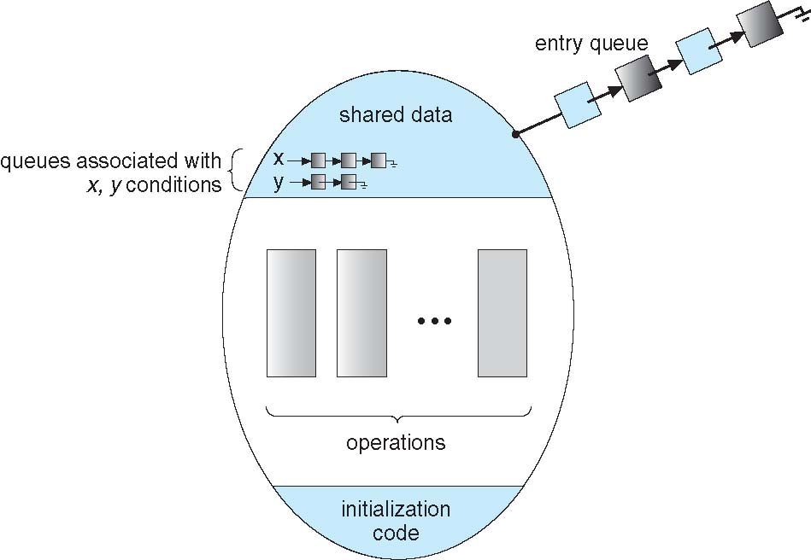
Monitor with Condition Variables

Slide 52
Condition Variables Choices
If process P invokes x.signal(), and process Q is suspended in x.wait(), what should happen next?
Both Q and P cannot execute in paralel. If Q is resumed, then P must wait
Options include
Signal and wait – P waits until Q either leaves the monitor or it waits for another condition
Signal and continue – Q waits until P either leaves the monitor or it waits for another condition
Both have pros and cons – language implementer can decide
Monitors implemented in Concurrent Pascal compromise
P executing signal immediately leaves the monitor, Q is resumed
Implemented in other languages including Mesa, C#, Java

Slide 53
Monitor Solution to Dining Philosophers
monitor DiningPhilosophers
{
enum { THINKING; HUNGRY, EATING) state [5] ;
condition self [5];
void pickup (int i) {
state[i] = HUNGRY;
test(i);
if (state[i] != EATING) self[i].wait;
}
void putdown (int i) {
state[i] = THINKING;
// test left and right neighbors
test((i + 4) % 5);
test((i + 1) % 5);
}

Slide 54
Solution to Dining Philosophers (Cont.)
void test (int i) {
if ((state[(i + 4) % 5] != EATING) &&
(state[i] == HUNGRY) &&
(state[(i + 1) % 5] != EATING) ) {
state[i] = EATING ;
self[i].signal () ;
}
}
initialization_code() {
for (int i = 0; i < 5; i++)
state[i] = THINKING;
}
}

Slide 55
Solution to Dining Philosophers (Cont.)
Each philosopher i invokes the operations pickup() and putdown() in the following sequence:
DiningPhilosophers.pickup(i);
EAT
DiningPhilosophers.putdown(i);
No deadlock, but starvation is possible

Slide 56
Monitor Implementation Using Semaphores
Variables
semaphore mutex; // (initially = 1)
semaphore next; // (initially = 0)
int next_count = 0;
Each procedure F will be replaced by
wait(mutex);
…
body of F;
…
if (next_count > 0)
signal(next)
else
signal(mutex);
Mutual exclusion within a monitor is ensured

Slide 57
Monitor Implementation – Condition Variables
For each condition variable x, we have:
semaphore x_sem; // (initially = 0)
int x_count = 0;
The operation x.wait can be implemented as:
x_count++;
if (next_count > 0)
signal(next);
else
signal(mutex);
wait(x_sem);
x_count--;

Slide 58
Monitor Implementation (Cont.)
The operation x.signal can be implemented as:
if (x_count > 0) {
next_count++;
signal(x_sem);
wait(next);
next_count--;
}

Slide 59
Resuming Processes within a Monitor
If several processes queued on condition x, and x.signal() executed, which should be resumed?
FCFS frequently not adequate
conditional-wait construct of the form x.wait(c)
Where c is priority number
Process with lowest number (highest priority) is scheduled next

Slide 60
Single Resource allocation
Allocate a single resource among competing processes using priority numbers that specify the maximum time a process plans to use the resource
R.acquire(t);
...
access the resurce;
...
R.release;
Where R is an instance of type ResourceAllocator

Slide 61
A Monitor to Allocate Single Resource
monitor ResourceAllocator
{
boolean busy;
condition x;
void acquire(int time) {
if (busy)
x.wait(time);
busy = TRUE;
}
void release() {
busy = FALSE;
x.signal();
}
initialization code() {
busy = FALSE;
}
}

Slide 62
Synchronization Examples
Solaris
Windows
Linux
Pthreads

Slide 63
Solaris Synchronization
Implements a variety of locks to support multitasking, multithreading (including real-time threads), and multiprocessing
Uses adaptive mutexes for efficiency when protecting data from short code segments
Starts as a standard semaphore spin-lock
If lock held, and by a thread running on another CPU, spins
If lock held by non-run-state thread, block and sleep waiting for signal of lock being released
Uses condition variables
Uses readers-writers locks when longer sections of code need access to data
Uses turnstiles to order the list of threads waiting to acquire either an adaptive mutex or reader-writer lock
Turnstiles are per-lock-holding-thread, not per-object
Priority-inheritance per-turnstile gives the running thread the highest of the priorities of the threads in its turnstile

Slide 64
Windows Synchronization
Uses interrupt masks to protect access to global resources on uniprocessor systems
Uses spinlocks on multiprocessor systems
Spinlocking-thread will never be preempted
Also provides dispatcher objects user-land which may act mutexes, semaphores, events, and timers
Events
An event acts much like a condition variable
Timers notify one or more thread when time expired
Dispatcher objects either signaled-state (object available) or non-signaled state (thread will block)

Slide 65
Linux Synchronization
Linux:
Prior to kernel Version 2.6, disables interrupts to implement short critical sections
Version 2.6 and later, fully preemptive
Linux provides:
Semaphores
Atomic integers
spinlocks
reader-writer versions of both
On single-cpu system, spinlocks replaced by enabling and disabling kernel preemption

Slide 66
Pthreads Synchronization
Pthreads API is OS-independent
It provides:
mutex locks
condition variable
Non-portable extensions include:
read-write locks
spinlocks

Slide 67
Alternative Approaches
Transactional Memory
OpenMP
Functional Programming Languages

Slide 68
Transactional Memory
A memory transaction is a sequence of read-write operations to memory that are performed atomically.
void update()
{
/* read/write memory */
}

Slide 69
OpenMP
OpenMP is a set of compiler directives and API that support parallel progamming.
void update(int value)
{
#pragma omp critical
{
count += value
}
}
The code contained within the #pragma omp critical directive is treated as a critical section and performed atomically.

Slide 70
Functional Programming
Languages
Functional programming languages offer a different paradigm than procedural languages in that they do not maintain state.
Variables are treated as immutable and cannot change state once they have been assigned a value.
There is increasing interest in functional languages such as Erlang and Scala for their approach in handling data races.

Slide 71
The Deadlock Problem
A set of blocked processes each holding a resource and waiting to acquire a resource held by another process in the set
Example
System has 2 disk drives
P₁ and P₂ each hold one disk drive and each needs another one
Example
semaphores A and B, initialized to 1
P₀ P₁
wait (A); wait(B)
wait (B); wait(A)

Slide 72
Bridge Crossing Example
Traffic only in one direction
Each section of a bridge can be viewed as a resource
If a deadlock occurs, it can be resolved if one car backs up (preempt resources and rollback)
Several cars may have to be backed up if a deadlock occurs
Starvation is possible
Note – Most OSes do not prevent or deal with deadlocks

Slide 73
Deadlock Example
/* thread one runs in this function */
void *do_work_one(void *param) {
pthread_mutex_lock(&first_mutex);
pthread_mutex_lock(&second_mutex);
/** * Do some work */ pthread_mutex_unlock(&second_mutex);
pthread_mutex_unlock(&first_mutex);
pthread_exit(0);
}
/* thread two runs in this function */
void *do_work_two(void *param) {
pthread_mutex_lock(&second_mutex);
pthread_mutex_lock(&first_mutex);
/** * Do some work */ pthread_mutex_unlock(&first_mutex);
pthread_mutex_unlock(&second_mutex);
pthread_exit(0);
}

Slide 74
Deadlock Example with Lock Ordering
void transaction(Account from, Account to, double amount)
{
mutex lock1, lock2;
lock1 = get_lock(from);
lock2 = get_lock(to);
acquire(lock1);
acquire(lock2);
withdraw(from, amount);
deposit(to, amount);
release(lock2);
release(lock1);
}
Transactions 1 and 2 execute concurrently. Transaction 1 transfers $25 from account A to account B, and Transaction 2 transfers $50 from account B to account A

Slide 75
Deadlock Characterization
Deadlock can arise if four conditions hold simultaneously.
Mutual exclusion: only one process at a time can use a resource
Hold and wait: a process holding at least one resource is waiting to acquire additional resources held by other processes
No preemption: a resource can be released only voluntarily by the process holding it, after that process has completed its task
Circular wait: there exists a set {P₀, P₁, …, P_{n}} of waiting processes such that P₀ is waiting for a resource that is held by P₁, P₁ is waiting for a resource that is held by P₂, …, P_{n–1} is waiting for a resource that is held by P_{n}, and P_{n} is waiting for a resource that is held by P₀.

Slide 76
Resource-Allocation Graph
A set of vertices V and a set of edges E.
V is partitioned into two types:
P = {P₁, P₂, …, P_{n}}, the set consisting of all the processes in the system
R = {R₁, R₂, …, R_{m}}, the set consisting of all resource types in the system
request edge – directed edge P_{i} → R_{j}
assignment edge – directed edge R_{j} → P_{i}

Slide 77
Resource-Allocation Graph (Cont.)
Process
Resource Type with 4 instances
P_{i} requests instance of R_{j}
P_{i} is holding an instance of R_{j}
P_{i}
R_{j}
P_{i}
R_{j}

Slide 78
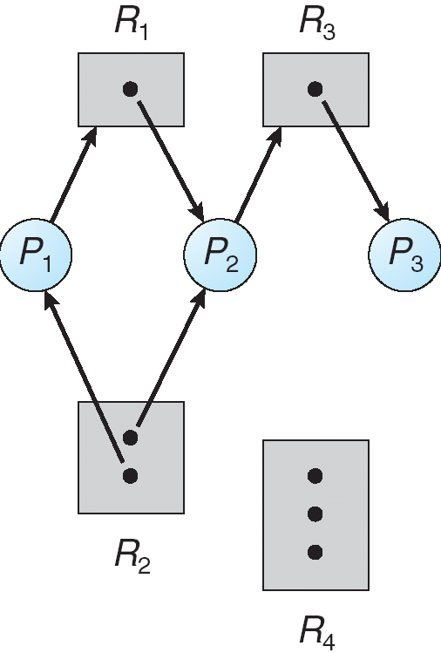
Example of a Resource Allocation Graph

Slide 79
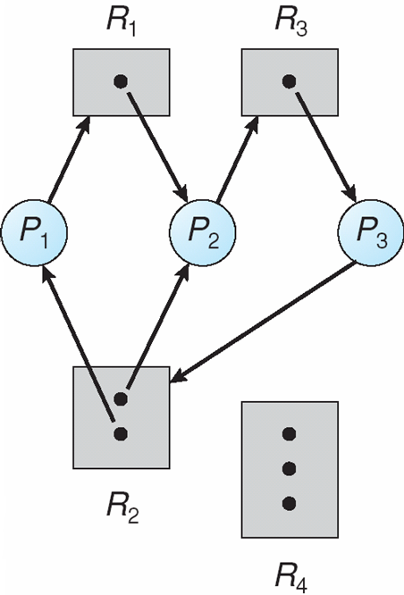
Resource Allocation Graph With A Deadlock

Slide 80
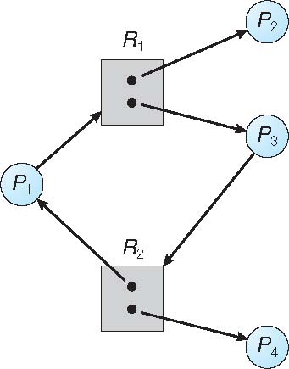
Graph With A Cycle But No Deadlock

Slide 81
Basic Facts
If graph contains no cycles ⇒ no deadlock
If graph contains a cycle ⇒
if only one instance per resource type, then deadlock
if several instances per resource type, possibility of deadlock

Slide 82
Methods for Handling Deadlocks
Ensure that the system will never enter a deadlock state:
Deadlock prevention
Deadlock avoidence
Allow the system to enter a deadlock state and then recover
Ignore the problem and pretend that deadlocks never occur in the system; used by most operating systems, including UNIX

Slide 83
End of Chapter 5

